Slide 1
To-Do List
Simple To-Do List Project in Python using Tkinter for the graphical user interface(GUI)

Slide 2
Here’s a simple To-Do List Project in Python using Tkinter for the graphical user interface(GUI).
Explanation:
GUI Components:
tk.Tk(): initializes the main window.
tk.Entry():Input field for users to type new tasks.
tk.Listbox():Displays the list of tasks.
tk.Button():Buttons to add tasks, delete tasks and mark tasks as completed.
Functions:
add_task(): Adds the text entered into the entry field to the Listbox.
delete_task (): Deletes the selected task from the Listbox.
mark_completed (): Marks the selected task as completed by adding”(Completed)” to the task text.
update_task(): Udates the selected task with the new value from the text entry.

Slide 3
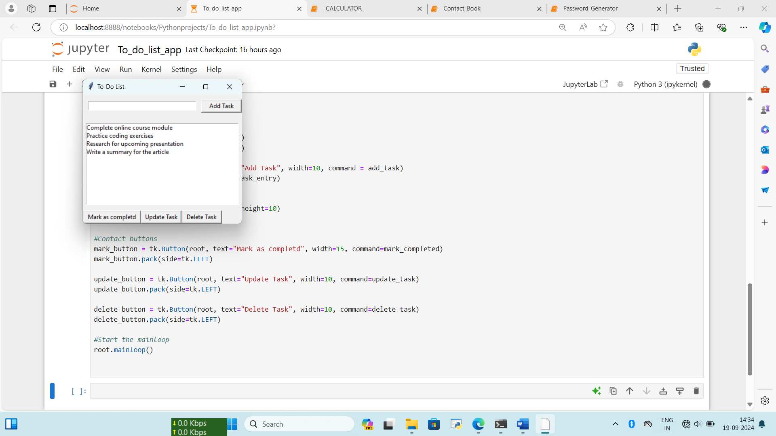
Output: add_task

Slide 4
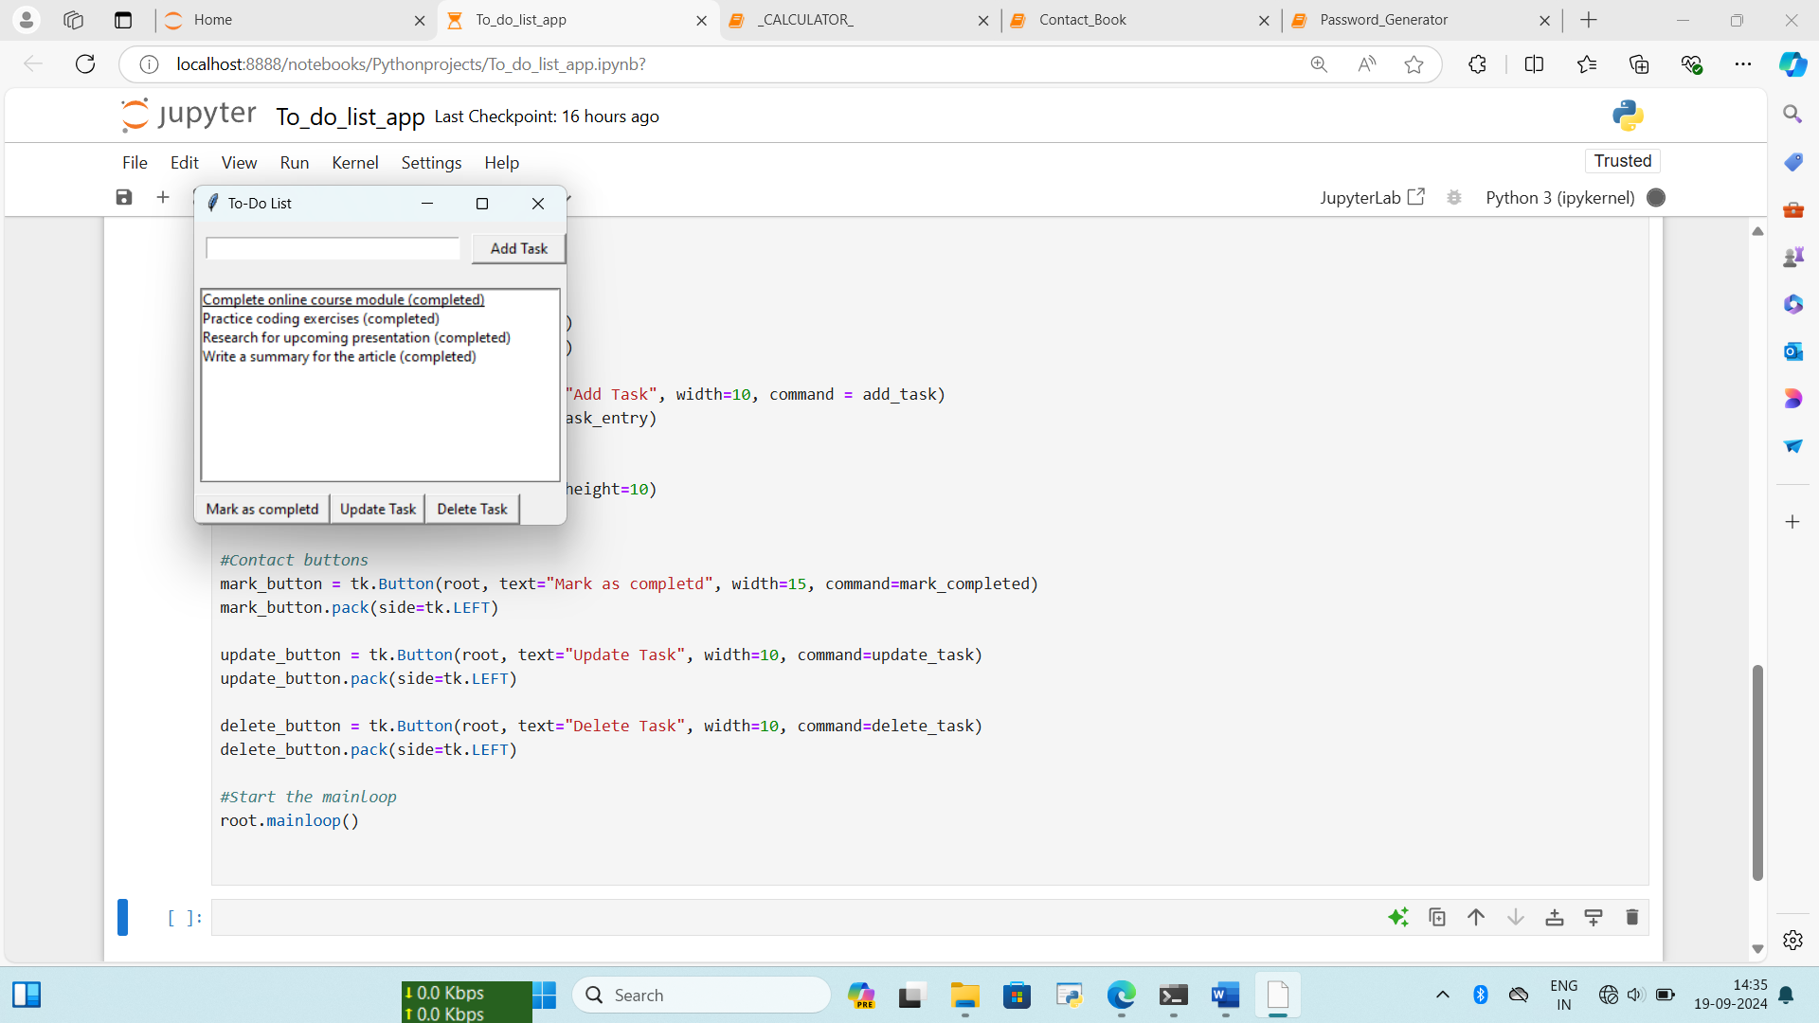
mark_completed:

Slide 5
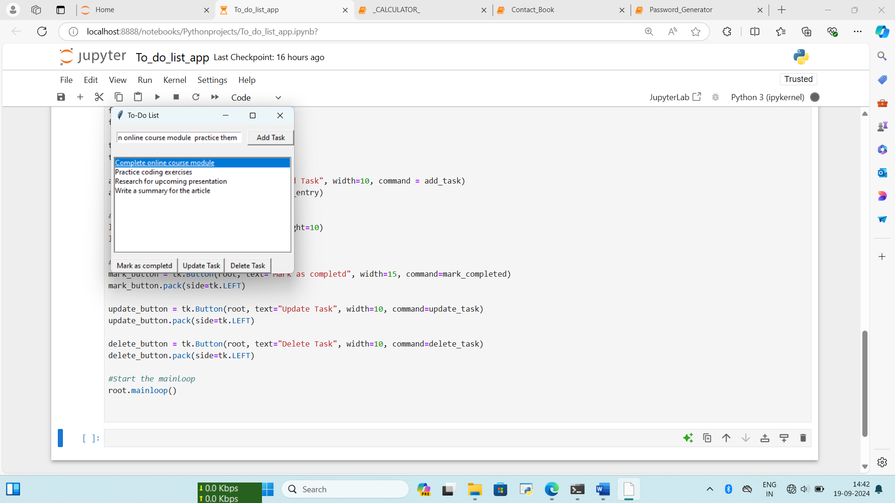
update_task:

Slide 6
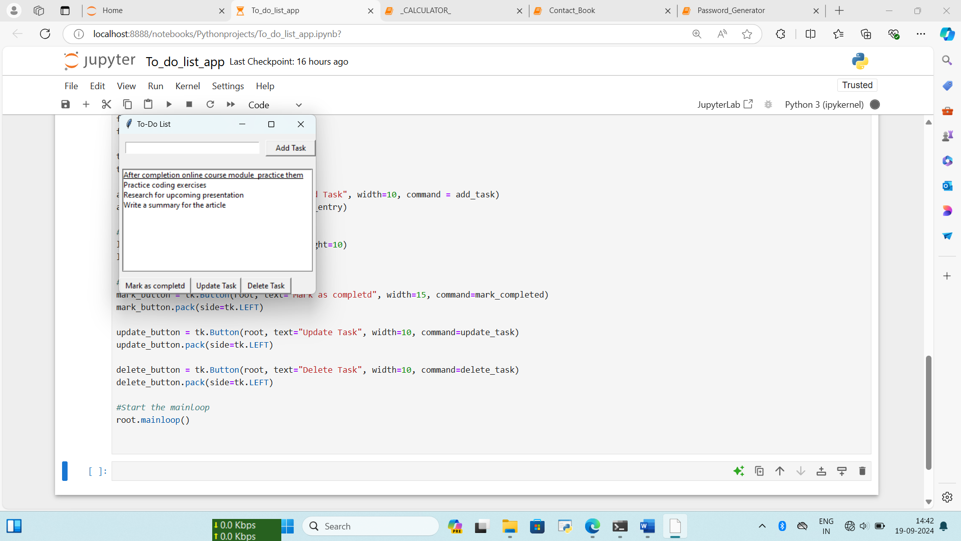
update_task:

Slide 7
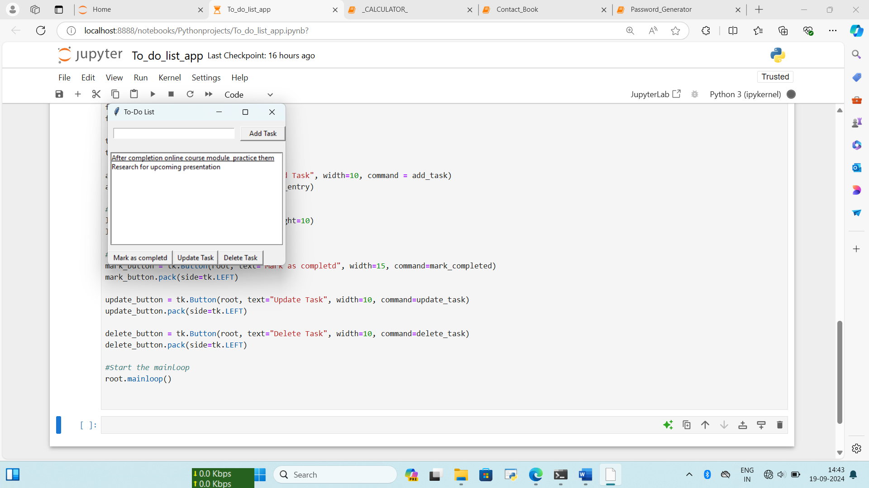
Delete_task:

Slide 8
This basic project can be further enhanced by adding features such as saving tasks to a file, editing tasks or adding deadlines.

